Slide 1
Main Memory
Operating Systems

Slide 2
Background
Program must be brought (from disk) into memory and placed within a process for it to be run
Main memory and registers are only storage CPU can access directly
Memory unit only sees a stream of addresses + read requests, or address + data and write requests
Register access in one CPU clock (or less)
Main memory can take many cycles, causing a stall, since it does not have the data required to complete the instruction that it is executing
Cache sits between main memory and CPU registers for fast access
Protection of memory required to ensure correct operation

Slide 3
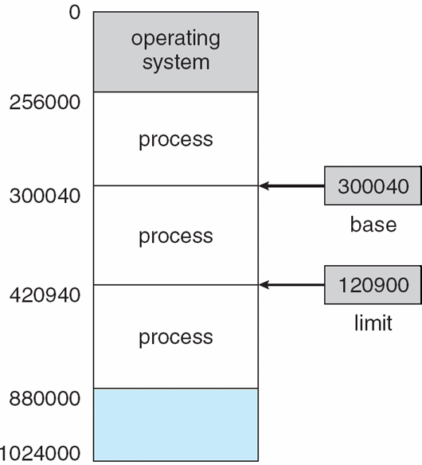
Base and Limit Registers
A pair of base and limit registers define the logical address space
CPU must check every memory access generated in user mode to be sure it is between base and limit for that user

Slide 4
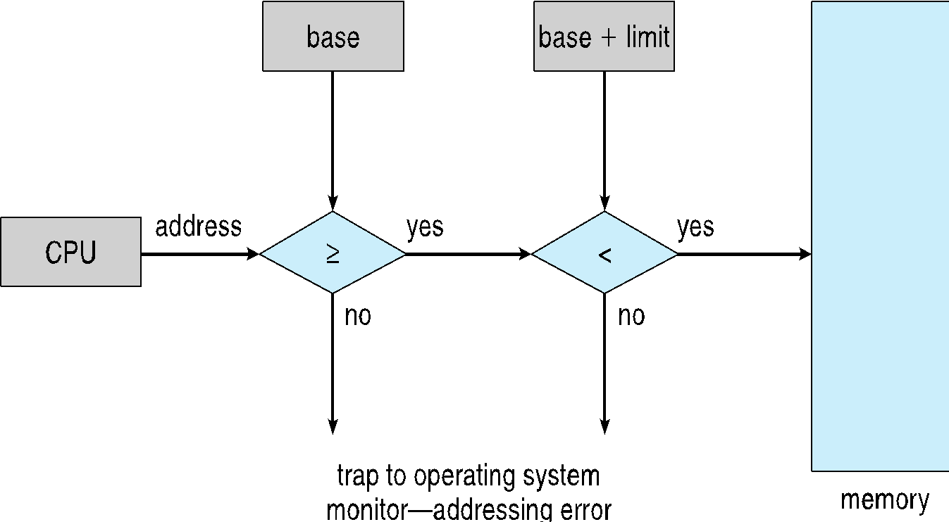
Hardware Address Protection

Slide 5
Operating Systems Address Space

Slide 6
Logical vs. Physical Address Space
The concept of a logical address space that is bound to a separate physical address space is central to proper memory management
Logical address – generated by the CPU; also referred to as virtual address
Physical address – address seen by the memory unit
Logical and physical addresses are the same in compile-time and load-time address-binding schemes; logical (virtual) and physical addresses differ in execution-time address-binding scheme
Logical address space is the set of all logical addresses generated by a program
Physical address space is the set of all physical addresses generated by a program

Slide 7
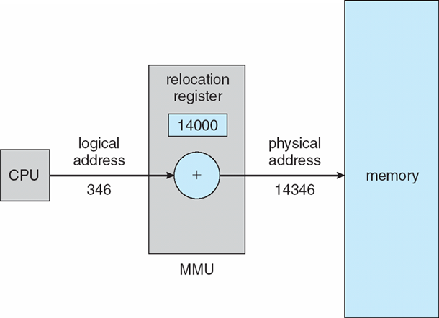
Memory-Management Unit (MMU)
MMU - Hardware device that at run time maps virtual to physical address
consider simple scheme where the value in the relocation register is added to every address generated by a user process at the time it is sent to memory
Base register now called relocation register
MS-DOS on Intel 80x86 used 4 relocation registers
The user program deals with logical addresses; it never sees the real physical addresses
Execution-time binding occurs when reference is made to location in memory
Logical address bound to physical addresses

Slide 8
Dynamic Loading
Routine is not loaded until it is called
Better memory-space utilization; unused routine is never loaded
All routines kept on disk in relocatable load format
Useful when large amounts of code are needed to handle infrequently occurring cases
No special support from the operating system is required
Implemented through program design
OS can help by providing libraries to implement dynamic loading

Slide 9
Dynamic Linking
Static linking – system libraries and program code combined by the loader into the binary program image
Dynamic linking – linking postponed until execution time
Small piece of code, stub, used to locate the appropriate memory-resident library routine
Stub replaces itself with the address of the routine, and executes the routine
Operating system checks if routine is in processes’ memory address
If not in address space, add to address space
Dynamic linking is particularly useful for libraries
System also known as shared libraries

Slide 10
Operating Systems Contiguous Allocation

Slide 11
Contiguous Allocation
Main memory must accommodate both OS and user processes
Limited resource, must allocate efficiently
Contiguous allocation is one early method
Main memory usually divided into two partitions:
Resident operating system, usually held in low memory with interrupt vector
User processes then held in high memory
Each process contained in single contiguous section of memory

Slide 12
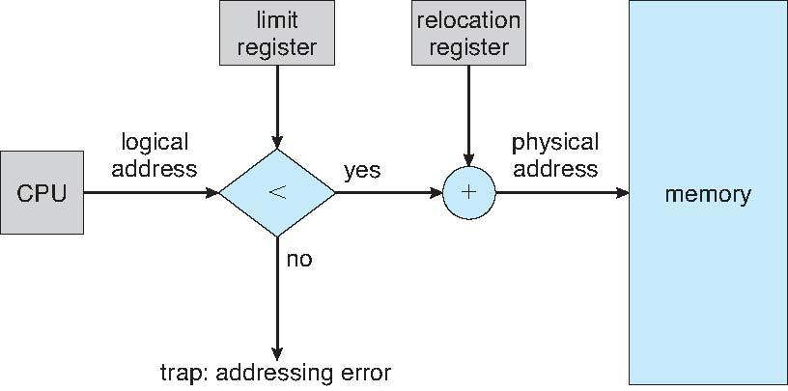
Contiguous Allocation
Relocation registers used to protect user processes from each other, and from changing operating-system code and data
Base register contains value of smallest physical address
Limit register contains range of logical addresses – each logical address must be less than the limit register
MMU maps logical address dynamically
Can then allow actions such as kernel code being transient and kernel changing size

Slide 13
Multiple-partition allocation
Multiple-partition allocation:
Fixed-sized partition: Degree of multiprogramming limited by number of partitions
Variable-partition sizes for efficiency (sized to a given process’ needs)
Hole – block of available memory; holes of various size are scattered throughout memory
When a process arrives, it is allocated memory from a hole large enough to accommodate it
Process exiting frees its partition, adjacent free partitions combined
Operating system maintains information about: a) allocated partitions b) free partitions (hole)

Slide 14
Operating Systems Dynamic Memory Allocation

Slide 15
Dynamic Storage-Allocation Problem
How to satisfy a request of size n from a list of free holes?
First-fit: Allocate the first hole that is big enough
Best-fit: Allocate the smallest hole that is big enough; must search entire list, unless ordered by size
Produces the smallest leftover hole
Worst-fit: Allocate the largest hole; must also search entire list
Produces the largest leftover hole

Slide 16
Fragmentation
External Fragmentation – total memory space exists to satisfy a request, but it is not contiguous
Internal Fragmentation – allocated memory may be slightly larger than requested memory; this size difference is memory internal to a partition, but not being used
For First fit, statistical analysis reveals that given N blocks allocated, another 0.5 N blocks lost to fragmentation
1/3 may be unusable -> 50-percent rule
Reduce external fragmentation by compaction
Shuffle memory contents to place all free memory together in one large block
Compaction is possible only if relocation is dynamic, and is done at execution time

Slide 17
Operating Systems Paging

Slide 18
Paging
Physical address space of a process can be noncontiguous; process is allocated physical memory whenever the latter is available
Avoids external fragmentation
Avoids problem of varying sized memory chunks
Divide physical memory into fixed-sized blocks called frames
Size is power of 2, between 512 bytes and 16 Mbytes
Divide logical memory into blocks of same size called pages
Keep track of all free frames
To run a program of size N pages, need to find N free frames and load program
Set up a page table to translate logical to physical addresses
Backing store likewise split into pages
Still have Internal fragmentation

Slide 19
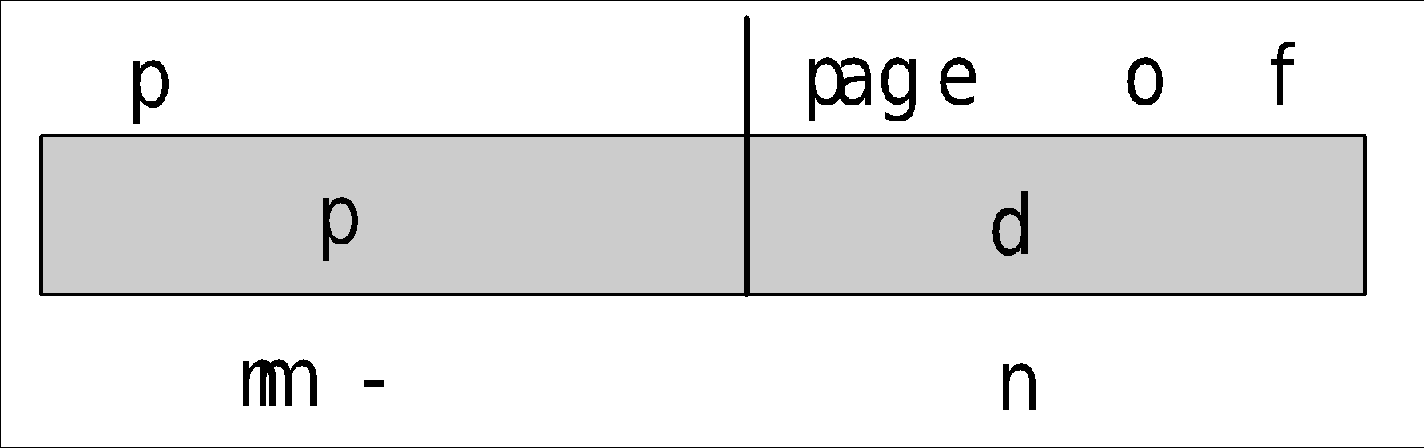
Address Translation Scheme
Address generated by CPU is divided into:
Page number (p) – used as an index into a page table which contains base address of each page in physical memory
Page offset (d) – combined with base address to define the physical memory address that is sent to the memory unit
For given logical address space 2^{m} and page size 2^{n}

Slide 20
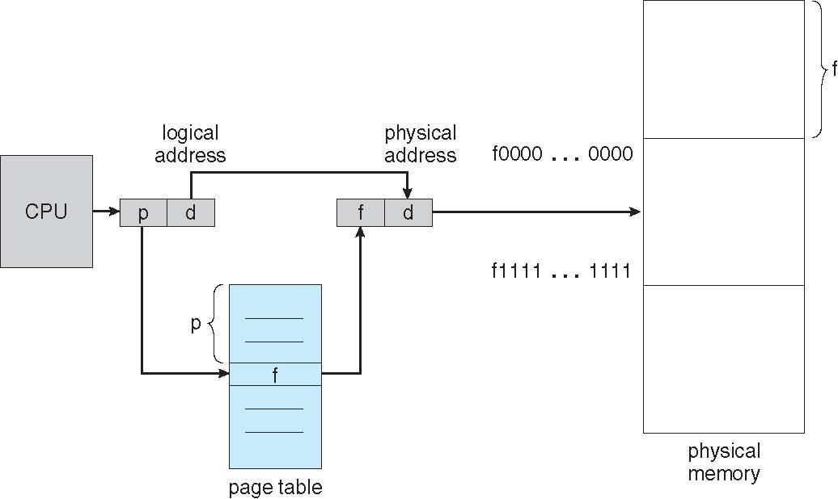
Paging Hardware

Slide 21
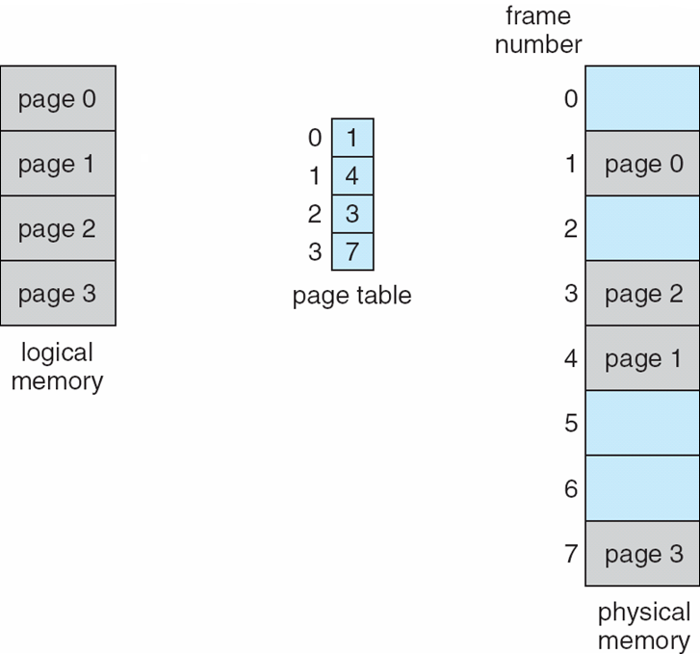
Paging Model of Logical and Physical Memory

Slide 22
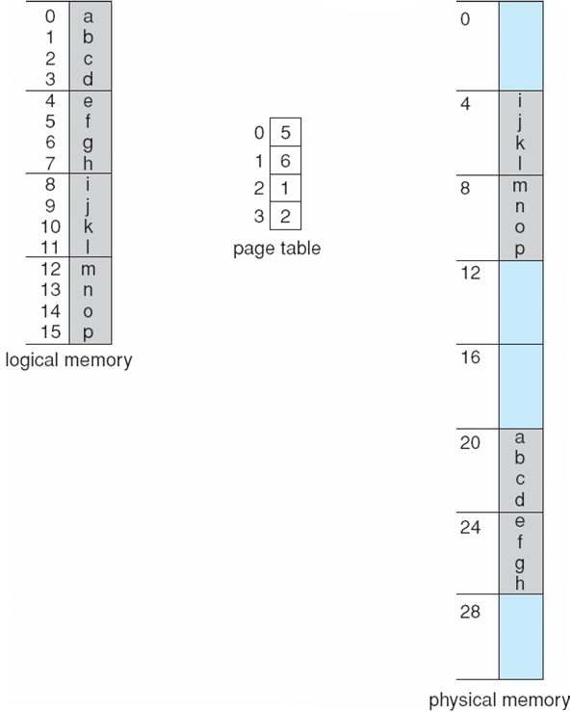
Paging Example
n=2 and m=2
32-byte memory and 4-byte pages

Slide 23
Size of Page
Calculating internal fragmentation
Page size = 2,048 bytes
Process size = 72,766 bytes
35 pages + 1,086 bytes
Internal fragmentation of 2,048 - 1,086 = 962 bytes
Worst case fragmentation = 1 frame – 1 byte
On average fragmentation = 1 / 2 frame size
So small frame sizes desirable?
But each page table entry takes memory to track
Page sizes growing over time
Solaris supports two page sizes – 8 KB and 4 MB
Process view and physical memory now very different
By implementation process can only access its own memory

Slide 24
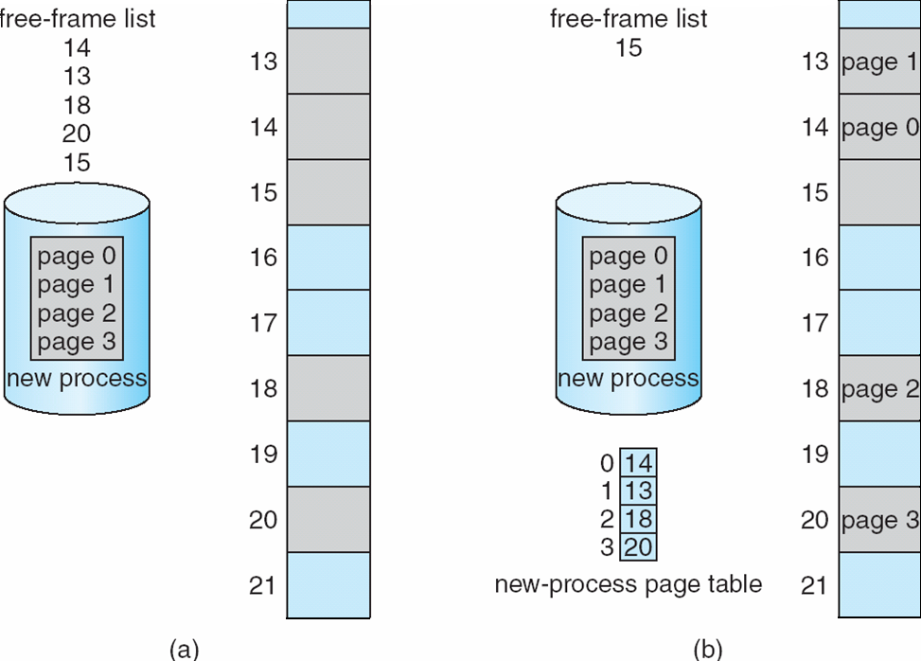
Free Frames
Before allocation
After allocation

Slide 25
Operating Systems Implementation of Page Table

Slide 26
Implementation of Page Table
Page table is kept in main memory
Page-table base register (PTBR) points to the page table
Page-table length register (PTLR) indicates size of the page table
In this scheme every data/instruction access requires two memory accesses
One for the page table and one for the data / instruction
The two memory access problem can be solved by the use of a special fast-lookup hardware cache called associative memory or translation look-aside buffers (TLBs)

Slide 27
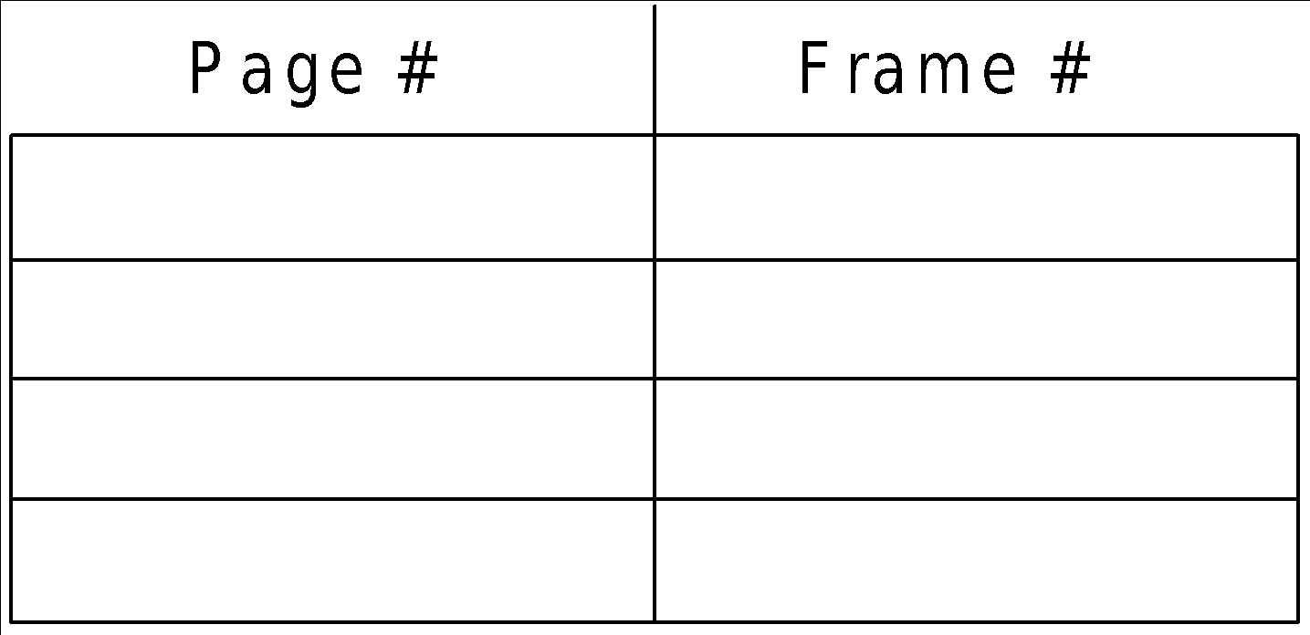
Associative Memory
Associative memory – parallel search
Address translation (p, d)
If p is in associative register, get frame # out
Otherwise get frame # from page table in memory

Slide 28
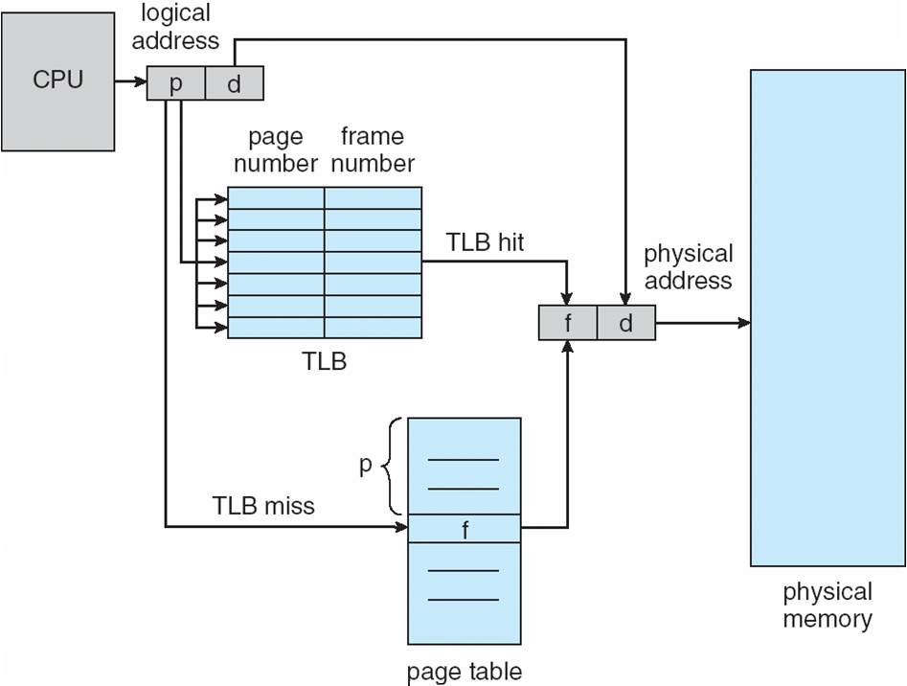
Paging Hardware With TLB

Slide 29
Effective Access Time
Associative Lookup = ε time unit
Can be < 10% of memory access time
Hit ratio = α
Hit ratio – percentage of times that a page number is found in the associative registers;
Consider α = 80%, ε = 20ns for TLB search, 100ns for memory access
Effective Access Time (EAT):
Consider α = 80%, ε = 20ns for TLB search, 100ns for memory access
EAT = 0.80 x 120 + 0.20 x 200 = 136ns
Consider more realistic hit ratio -> α = 99%, ε = 20ns for TLB search, 100ns for memory access
EAT = 0.99 x 120 + 0.01 x 200 = 120.8ns

Slide 30
Operating Systems Shared Pages

Slide 31
Shared Pages
Shared code
One copy of read-only (reentrant) code shared among processes (i.e., text editors, compilers, window systems)
Similar to multiple threads sharing the same process space
Also useful for inter-process communication if sharing of read-write pages is allowed
Private code and data
Each process keeps a separate copy of the code and data
The pages for the private code and data can appear anywhere in the logical address space

Slide 32
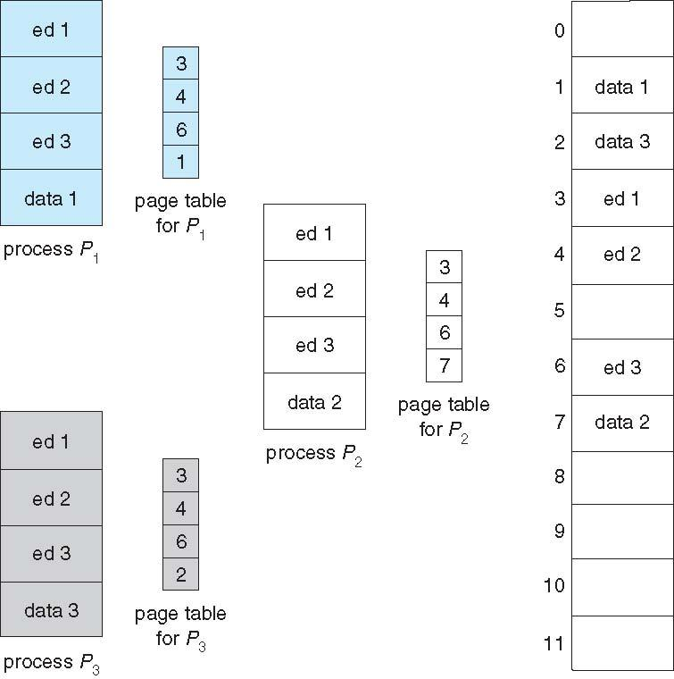
Shared Pages Example

